Slide 1
Chapter Four (Part 1): JavaScript
Dr. Nabil Almashfi

Slide 2
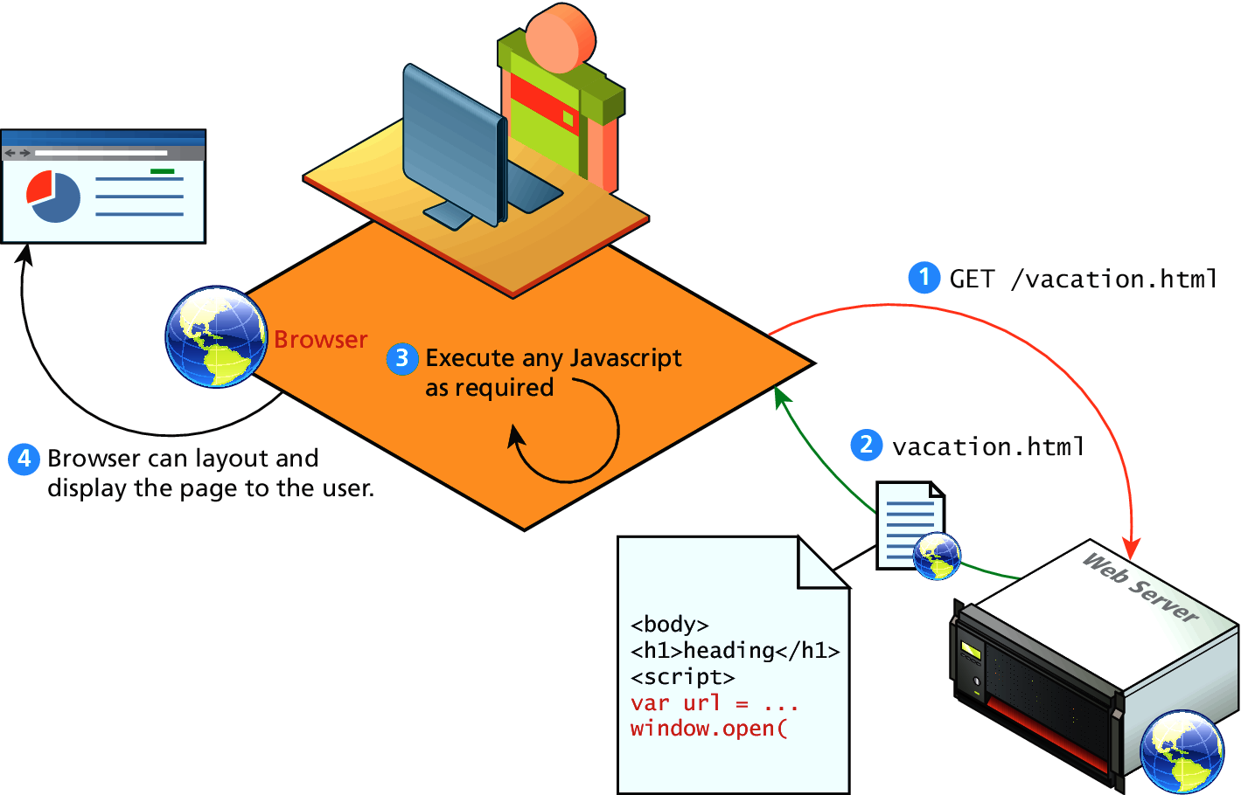
Introduction
JavaScript is the world's most popular programming language.
JavaScript is used to program the behavior of web pages.
JavaScript can change: HTML Content, HTML Attribute Values, HTML Styles (CSS), HTML Elements, and HTML Elements.
You don't have to get or download JavaScript.
JavaScript is already running in your browser on your computer, on your tablet, and on your smart-phone.
JavaScript is free to use for everyone.

Slide 3
Client-Side Scripting
There are many advantages of client-side scripting:
Processing can be offloaded from the server to client machines, thereby reducing the load on the server.
The browser can respond more rapidly to user events than a request to a remote server ever could, which improves the user experience.
JavaScript can interact with the downloaded HTML in a way that the server cannot, creating a user experience more like desktop software than simple HTML ever could.

Slide 4
Where does JavaScript go?
JavaScript can be linked to an HTML page in a number of ways:
Inline JavaScript
Embedded JavaScript
External JavaScript

Slide 5
Inline JavaScript
Refers to the practice of including JavaScript code directly within certain HTML attributes
Inline JavaScript is a real maintenance nightmare.
<input type="button" onclick="alert('Hi all')"/>

Slide 6
Embedded JavaScript
Refers to the practice of placing JavaScript code within a <script> element.
<body>
<script>
alert('Hi al2222’) ;
</script>
</body>

Slide 7
External JavaScript
JavaScript supports this separation by allowing links to an external file that contains the JavaScript.
By convention, JavaScript external files have the extension .js
<input type="button" onclick="test()"/>
<!-- Load external JavaScript -->
<script src="scripts.js" >
</script>
function test(){
alert("hi all123 ");
}

Slide 8
JavaScript Synatx

Slide 9
JavaScript Variables
JavaScript Variables can be declared in 4 ways:
Automatically
Using var
For older browsers.
Using let
Can be changed.
Using const
For constant values and cannot be changed.
Variables in JavaScript are dynamically typed, meaning a variable can be an integer, and then later a string, then later an object, if so desired.
x = 5;
var y = 5;
let z = 6; const s = 6;

Slide 10
JavaScript Identifiers
All JavaScript variables must be identified with unique names.
Names can contain letters, digits, underscores, and dollar signs.
Names must begin with a letter.
Names can also begin with $ and _
Names are case sensitive (y and Y are different variables).
Reserved words (like JavaScript keywords) cannot be used as names

Slide 11
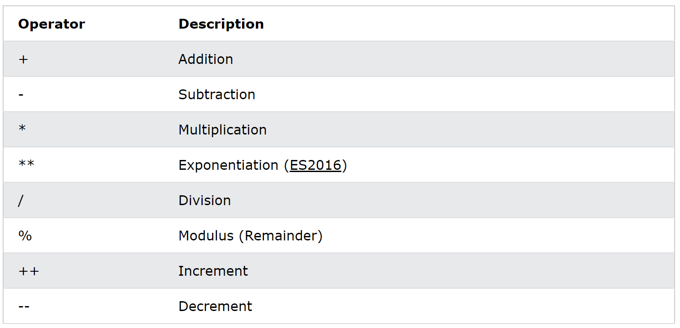
Arithmetic Operators

Slide 12
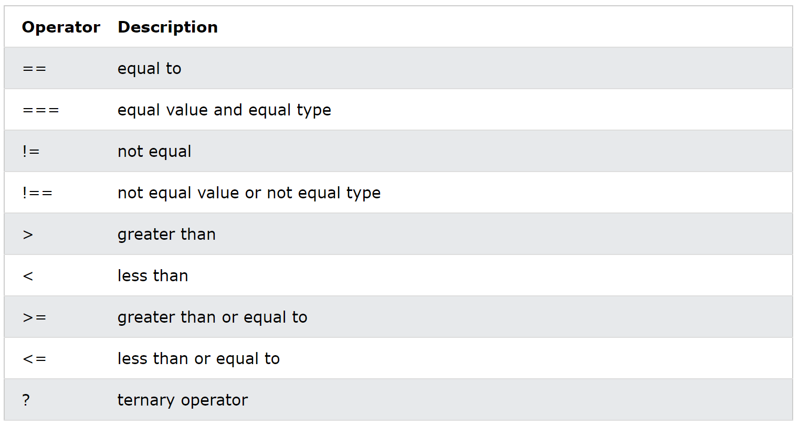
Comparison Operators

Slide 13
JavaScript Conditional Statements
In JavaScript we have the following conditional statements: if, else, else if, and switch.
if (hour < 18) { greeting = "Good day"; }
if (time < 10) { greeting = "Good morning"; } else if (time < 20) { greeting = "Good day"; } else { greeting = "Good evening"; }
if (hour < 18) { greeting = "Good day"; } else { greeting = "Good evening"; }

Slide 14
JavaScript Loops
JavaScript supports different kinds of loops: for, for/in, for/of, while, and do/while.
for (let i = 0; i < 5; i++) { text += "The number is " + i + "<br>"; }

Slide 15
JavaScript Functions
They are defined by using the reserved word function and then the function name and (optional) parameters.
Since JavaScript is dynamically typed, functions do not require a return type, nor do the parameters require type.
// Compute the product of p1 and p2 function myFunction(p1, p2) { return p1 * p2; }
function power(x, y) {
var pow = 1;
for (var i = 0; i < y; i++) {
pow = pow * x;
}
return pow;
}
//called as
power(2,5);

Slide 16
JavaScript Objects (1)
Objects in JavaScript are variables too, but objects can contain many values.
There are objects that are included in the JavaScript language; you can also define your own kind of objects.
You define (and create) a JavaScript object with an object literal.
The values are written as name:value pairs (name and value separated by a colon).
You can access object properties in two ways:
objectName.propertyName
objectName["propertyName"]
const car = {type:"Fiat", model:"500", color:"white"};
let x = car.type;
let y = car["type"];

Slide 17
JavaScript Objects (2)
Objects can also have methods.
Methods are stored in properties as function definitions.
You can access object methods as:
objectName.methodName()
A number of useful objects are included with JavaScript including:
Array
Boolean
Date
Math
String
Dom objects (More on this later)
const person = { firstName: "John", lastName : "Doe", id : 5566, fullName : function() { return this.firstName + " " + this.lastName; } };

Slide 18
JavaScript Events (1)
HTML events are "things" that happen to HTML elements.
An HTML event can be something the browser does, or something a user does.
JavaScript lets you execute code when events are detected.
We say then that an event is triggered and then it can be caught by JavaScript functions, which then do something in response.
HTML allows event handler attributes, with JavaScript code, to be added to HTML elements.
Two approaches to define JavaScript events:
Inline Event Handler Approach
Listener Approach (Not Covered)

Slide 19
JavaScript Events (2)
Inline Event Handler Approach:
In the following example, an onclick attribute (with code), is added to a <button> element which will cause an alert to pop-up when the button is clicked.
JavaScript code is often several lines long. It is more common to see event attributes calling functions:
<button onclick="alert('demo')">Click me</button>
<button onclick="myFun()">Click me</button>
<script>
function myFun() {
alert('demo’);
}
</script>

Slide 20
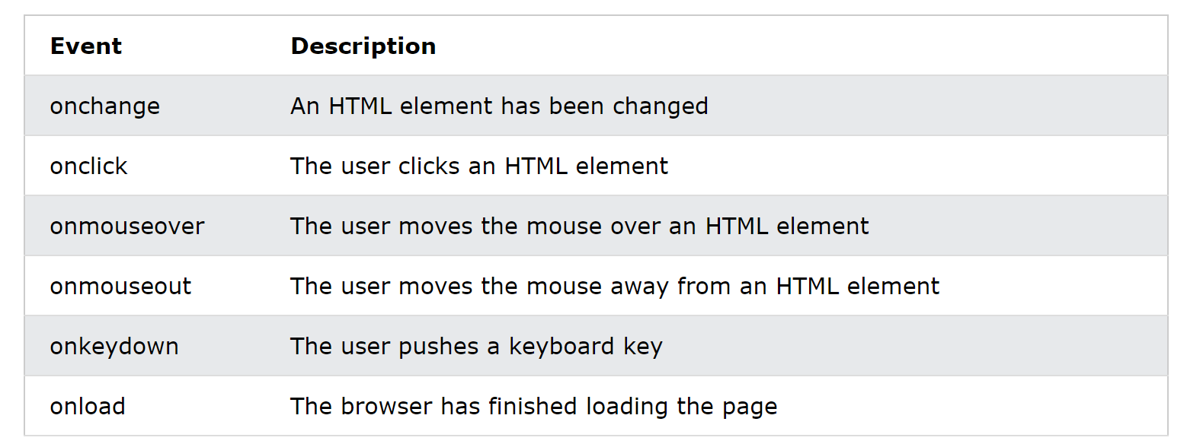
JavaScript Events (3)
Common HTML Events:

Slide 21
References
https://www.w3schools.com/css/
https://developer.mozilla.org/en-US/docs/Web/CSS

